Slide 1

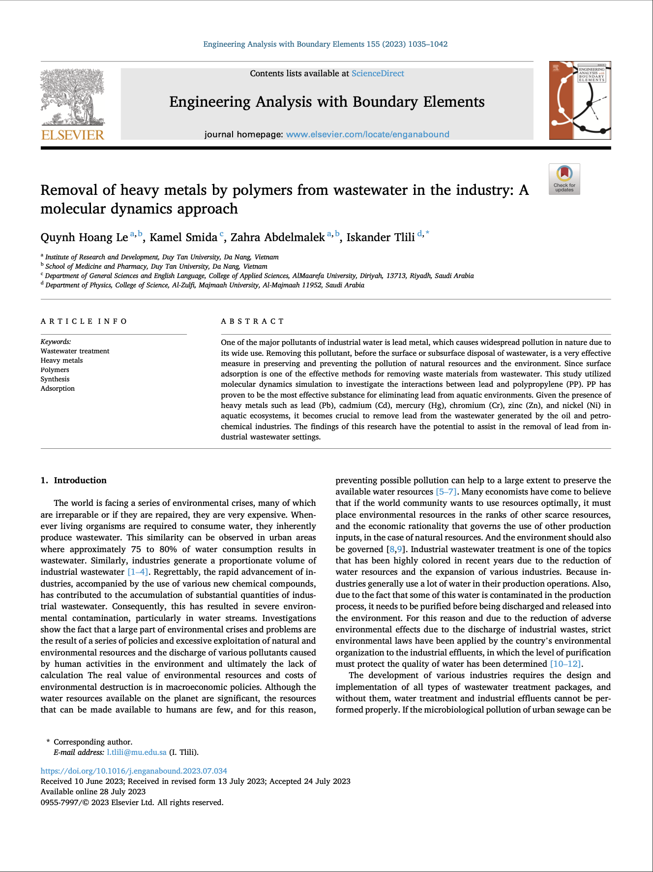

Removal of heavy metals by polymers from wastewater in the industry: A molecular dynamic approach
CL311 (technical writing & presentation) Group : 28 Kesh Pratap Singh (210107042) Ravi Bhusan Pratap (210107070) Dhruv Agarwal (210107024)

Slide 2

CONTENT
INTRODUCTION
OBJECTIVE
METHODOLOGY
RESULT & DISCUSSION
CONCLUSION
REFERENCE
FUTURE WORK

Slide 3
INTRODUCTION
Addresses the urgent need to remove lead from wastewater.
Polypropylene (PP) is investigated as a potential adsorbent for lead removal.
Explores the spatial distribution, conformational changes, and energy landscape of polymers at different concentrations.
Findings provide insights for the design and optimization of polymer-based materials for industrial applications.

Slide 4

OBJECTIVE
Investigate PP's effectiveness in removing lead from industrial wastewater.
Analyze the spatial distribution and conformational changes of polymers during lead adsorption.
Provide insights for optimizing polymer based materials for efficient lead removal.

Slide 5
METHODOLOGY
Molecular dynamics(MD) simulations performed with PP polymer concentrations of 10, 15, 20, and 25, respectively.
The simulations were conducted using the LAMMPS software.
The structural and energetic properties of the polymer systems were analyzed using various techniques.
1.Gyration Radius analysis 2.RMSD analysis 3.RMSF analysis 4.SASA analysis

Slide 6

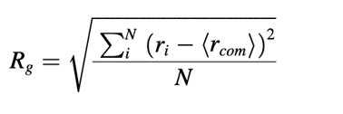
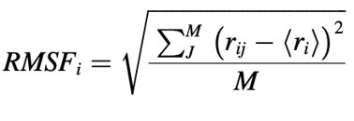
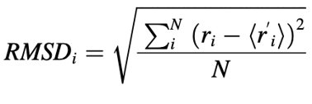
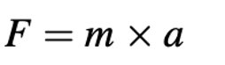
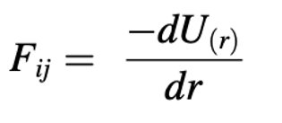
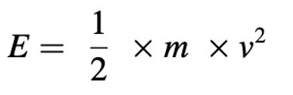
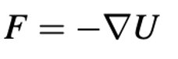
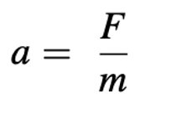
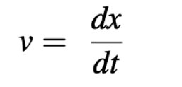
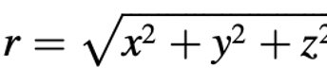
FORMULAS

Slide 7
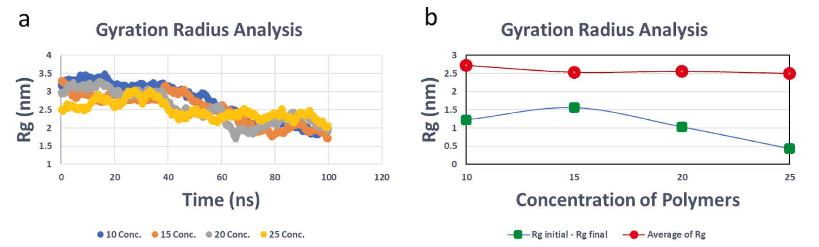
RESULT & DISCUSSION
The gyration radius exhibited temporal variations for all polymer concentrations examined over time based on the analysis.
Differences were observed between the initial and final gyration radii values.
Chart a is time-dependent Rg analysis for different simulations.
Chart b is differential of the initial and final Rg and the average Rg for the simulations.

Slide 8

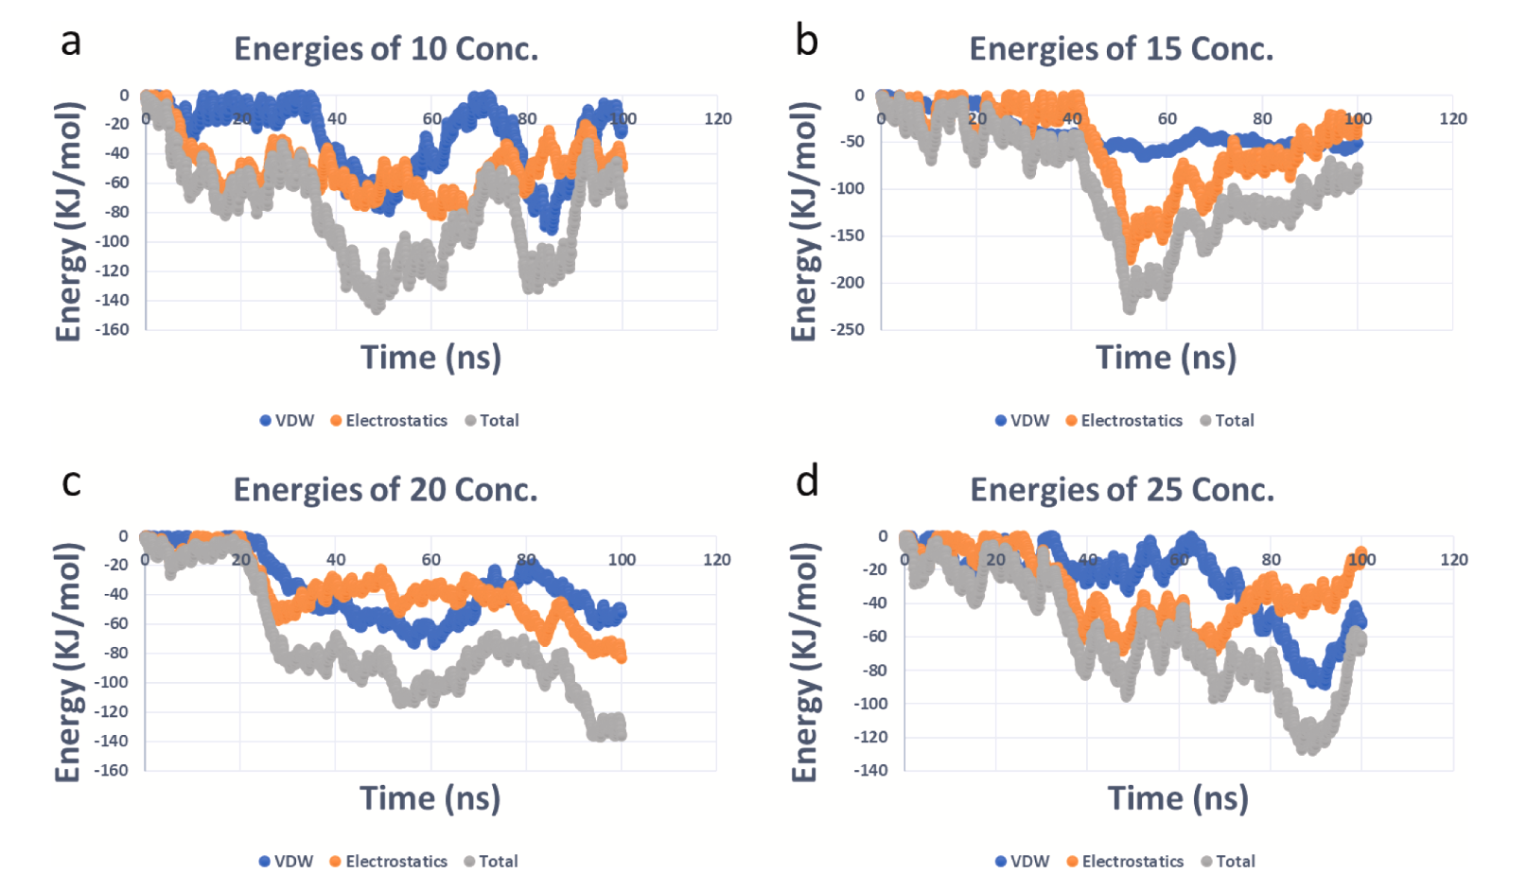
Average energy values vary significantly depending on polymer concentration, with concentration 15 showing the most favorable energies followed by 10, 20 and 25.
Average energy values in the system were dependent on both VDW and electrostatic contributions, though VDW was more dominant for most concentrations.
Time-dependent analysis of and electrostatic and van der Waals (VDW) energies, as well as the total, for various concentrations.

Slide 9
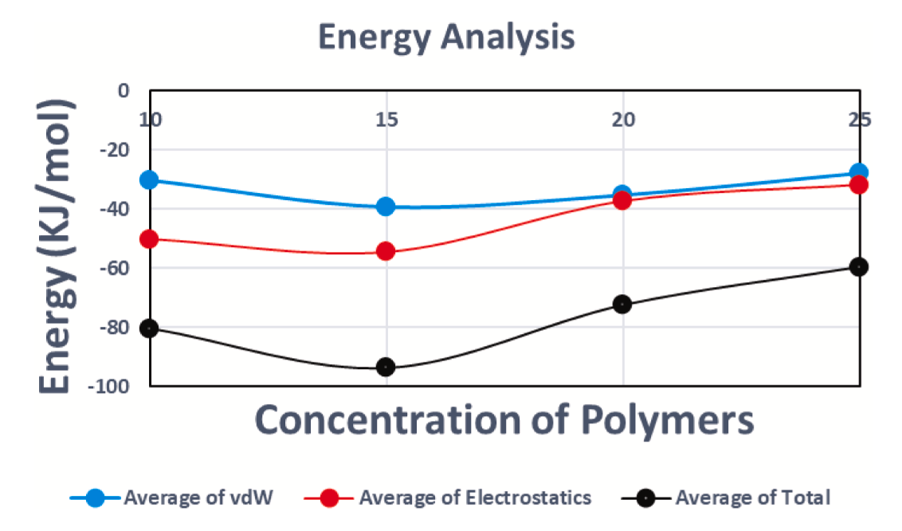
Polymer concentration 15 exhibited the lowest energy values over time based on analysis of electrostatic, VDW and total energies, with concentrations 10, 20 and 25 following closely behind.
Average analysis of electrostatic, total, and van der Waals (VDW) energies. Blue bar: average VDW energy, Red bar: average electrostatic energy, Black bar: average total energy.

Slide 10
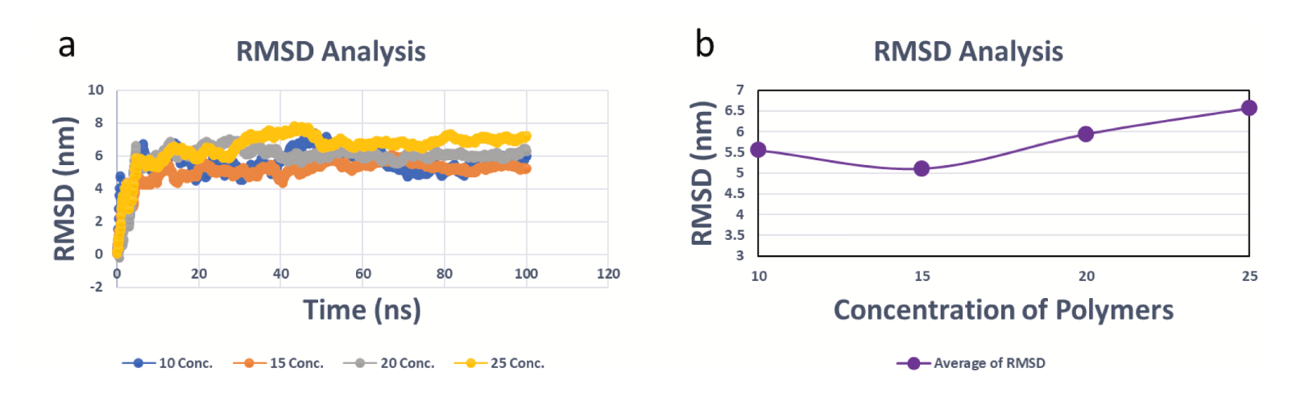
RMSD values varied over time for all concentrations but reached a plateau, indicating stable conformations were achieved.
Concentration 15 had lowest average RMSD values, followed by 10, 20, 25 indicating better structural stability.
Chart a: time-dependent analysis of root-mean-square deviation (RMSD) for different polymer concentrations.
Chart b: average RMSD analysis.

Slide 11
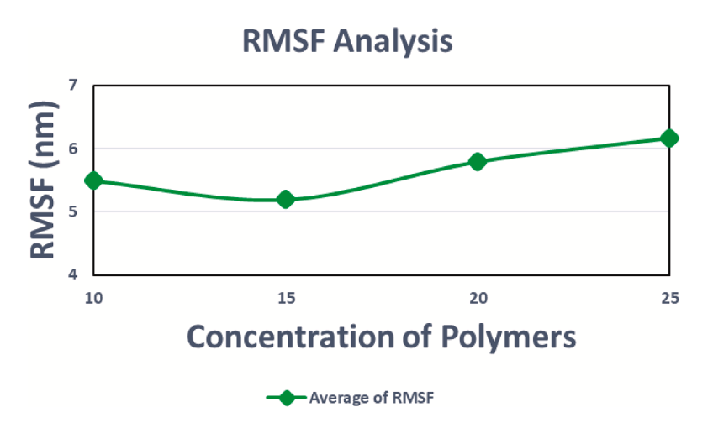
Polymer concentration 15 had the lowest average RMSF values, indicating a more stable system structure.
Backbone fluctuations dominated most concentrations, but side-chain fluctuations increased at higher concentrations.
Average analysis of RMSF for different polymer concentrations in the simulations.

Slide 12
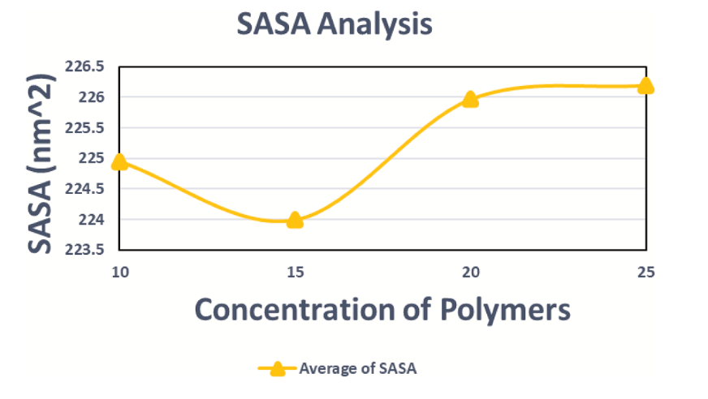
Polymer concentration of 15 had the lowest average SASA values, indicating the most compact surface area.
Visual analysis showed concentration 15 formed the most tightly packed and ordered final structure compared to other concentrations.
Average analysis of solvent-accessible surface area (SASA) for different polymer concentrations in the simulations.

Slide 13
CONCLUSION
Polypropylene effectively adsorbs lead atoms from wastewater streams.
Molecular dynamics simulations show polypropylene remains stable when removing lead in water environments.
Polypropylene proves to be an optimal material for removing lead from petrochemical plant effluents.
This research enables practical and safe application of polypropylene for lead removal in the oil and petrochemical industries.

Slide 14
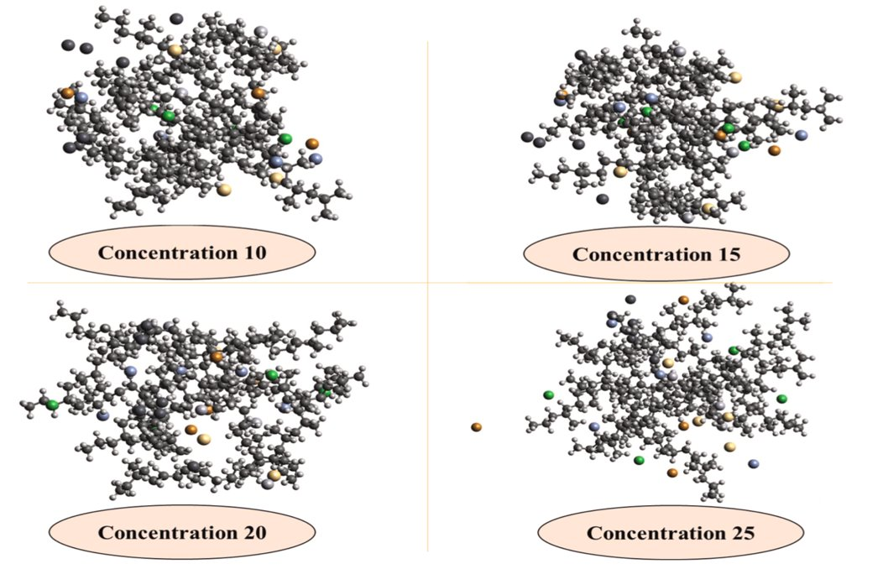
Final frame of simulations at the different concentrations. Polymer is PP and heavy metals include Lead (Pb), Mercury (Hg),Zinc (Zn), Chromium (Cr), Cadmium (Cd), and Nickel (Ni).

Slide 15
FUTURE WORK
Simulate the adsorption of other heavy metals like cadmium, mercury, chromium etc. on PP polymer to evaluate its effectiveness in removing multiple pollutants from industrial wastewater.
Conduct experiments to validate the results from molecular dynamics simulation of lead adsorption on PP. This will help in practical application of PP for industrial wastewater treatment.
Study the effect of parameters like temperature, pressure, polymer chain length etc. on the adsorption mechanism and capacity. Optimizing these parameters can further enhance the pollutant removal efficiency.

Slide 16
REFERENCE
[1] Van Vliet MT, et al. Global water scarcity including surface water quality and expansions of clean water technologies. Environ Res Lett 2021;16(2):024020.
[2] Salgot M, et al. Criteria for wastewater treatment and reuse under water scarcity. Handbook of drought and water scarcity. CRC Press; 2017. p. 263–82.
[3] Zhang Y, Shen Y. Wastewater irrigation: past, present, and future. Wiley Interdiscip Rev 2019;6(3):e1234.
[4] Ungureanu N, Vl˘ aduț V, Voicu G. Water scarcity and wastewater reuse in crop irrigation. Sustainability 2020;12(21):9055.
[5] Pandey A, et al. Utilization of solar energy for wastewater treatment: challenges and progressive research trends. J Environ Manage 2021;297:113300.
[6] Zhang D, et al. Water scarcity and sustainability in an emerging economy: a management perspective for future. Sustainability 2020;13(1):144.
[7] Obotey Ezugbe E, Rathilal S. Membrane technologies in wastewater treatment: a review. Membranes 2020;10(5):89. [8] Ibrahim I, et al. Semiconductor photothermal materials enabling efficient solar steam generation toward desalination and wastewater treatment. Desalination 2021;500:114853.
[9] Tzanakakis VA, Paranychianakis NV, Angelakis AN. Water supply and water scarcity. MDPI; 2020. p. 2347.
[10] Ribeiro JP, Nunes MI. Recent trends and developments in Fenton processes for industrial wastewater treatment–a critical review. Environ Res 2021;197:110957.
[11] Shahedi A, et al. A review on industrial wastewater treatment via electrocoagulation processes. Curr Opin Electrochem 2020;22:154–69.
[12] Dutta D, Arya S, Kumar S. Industrial wastewater treatment: current trends, bottlenecks, and best practices. Chemosphere 2021;285:131245.

Slide 17
[13] Kang D, et al. A dual hesitant q-rung orthopair enhanced MARCOS methodology under uncertainty to determine a used PPE kit disposal. Environ Sci Pollut Res 2022:1–18. [14] Wang K, et al. Antibiotic residues in wastewaters from sewage treatment plants and pharmaceutical industries: occurrence, removal and environmental impacts. Sci Total Environ 2021;788:147811. [15] Palani G, et al. Current trends in the application of nanomaterials for the removal of pollutants from industrial wastewater treatment—a review. Molecules 2021;26 (9):2799. [16] Owodunni AA, Ismail S. Revolutionary technique for sustainable plant-based green coagulants in industrial wastewater treatment—a review. J Water Process Eng 2021;42:102096. [17] Kishor R, et al. Ecotoxicological and health concerns of persistent coloring pollutants of textile industry wastewater and treatment approaches for environmental safety. J Environ Chem Eng 2021;9(2):105012. Fig. 7. Final frame of simulations at the different concentrations. Polymer is PP and heavy metals include Lead (Pb), Mercury (Hg),Zinc (Zn), Chromium (Cr), Cadmium (Cd), and Nickel (Ni). Q.H. Le et al. Engineering Analysis with Boundary Elements 155 (2023) 1035–1042 1042. [18] Asami H, Golabi M, Albaji M. Simulation of the biochemical and chemical oxygen demand and total suspended solids in wastewater treatment plants: data-mining approach. J Clean Prod 2021;296:126533. [19] Chai WS, et al. A review on conventional and novel materials towards heavy metal adsorption in wastewater treatment application. J Clean Prod 2021;296:126589. [20] Ajiboye TO, Oyewo OA, Onwudiwe DC. Simultaneous removal of organics and heavy metals from industrial wastewater: a review. Chemosphere 2021;262: 128379. [21] Fei Y, Hu YH. Design, synthesis, and performance of adsorbents for heavy metal removal from wastewater: a review. J Mater Chem A 2022;10(3):1047–85.

Slide 18
[22] Sharma P, et al. Critical review on microbial community during in-situ bioremediation of heavy metals from industrial wastewater. Environ Technol Innov 2021;24:101826.
[23] Maleki R, Asadnia M, Razmjou A. Artificial intelligence-based material discovery for clean energy future. Adv Intell Syst 2022;4(10):2200073.
[24] Khedri M, et al. Artificial intelligence deep exploration of influential parameters on physicochemical properties of curcumin-loaded electrospun nanofibers. Adv NanoBiomed Res 2022;2(6):2100143.
[25] Ahmed J, Thakur A, Goyal A. Industrial wastewater and its toxic effects. 2021.
[26] Velusamy S, et al. A review on heavy metal ions and containing dyes removal through graphene oxide-based adsorption strategies for textile wastewater treatment. Chem Rec 2021;21(7):1570–610.
[27] Sarigiannis DA, et al. Neurodevelopmental exposome: the effect of in utero coexposure to heavy metals and phthalates on child neurodevelopment. Environ Res 2021;197:110949.
[28] Brumatti LV, et al. Impact of methylmercury and other heavy metals exposure on neurocognitive function in children aged 7 years: study protocol of the follow-up. J Epidemiol 2021;31(2):157–63.
[29] Szukalska M, et al. Toxic metals in human milk in relation to tobacco smoke exposure. Environ Res 2021;197:111090.
[30] Zeng HL, et al. Associations of essential and toxic metals/metalloids in whole blood with both disease severity and mortality in patients with COVID-19. FASEB J 2021; 35(3).
[31] Munir N, et al. Heavy metal contamination of natural foods is a serious health issue: a review. Sustainability 2022;14(1):161.
[32] Wrzecinska ´ M, et al. Disorders of the reproductive health of cattle as a response to exposure to toxic metals. Biology 2021;10(9):882.

Slide 19

Thank you

